Slide 1


Home Inventory Manager Project
Internship At
Suven Consultants & Technology Pvt. Ltd.
Done by
Yash Joshi (18IT442)
Information Technology Department
Birla Vishvakarma Mahavidyalaya Engineering College
(An Autonomous Institution)
AY: 2020-21

Slide 2
Abstract :
Projects : Home Inventory Manager Project
Language & Technology used : java using VScode
Duration : 4 weeks

Slide 3

2. Home Inventory Manager Project

Slide 4
AIM :
To build home inventory manager to keep record of your belongings.
Scop :
Home inventory manager is built to keep tracks of Your items by their photos and serial number.
For an example If you want to buy something and you can check in This manager to find if you have this item or not.

Slide 5
Implementation :
The idea of the program is to enter and/or view descriptive information about each item in your inventory. You can enter:
1. Inventory Item A description of the item (required)
2. Location Description of where item is located
3. Marked Indicates if item is marked with some kind of identifying
4. Information (social security number, driver’s license number, phone number)
5. Serial Number Item serial number
6. Purchase Price How much you paid for the item.
7. Date Purchased When you purchased the item.
8. Store/Website Where you purchased the item.
9. Note Any additional information about the item.
10. Photo View a stored JPEG photo of the item.

Slide 6
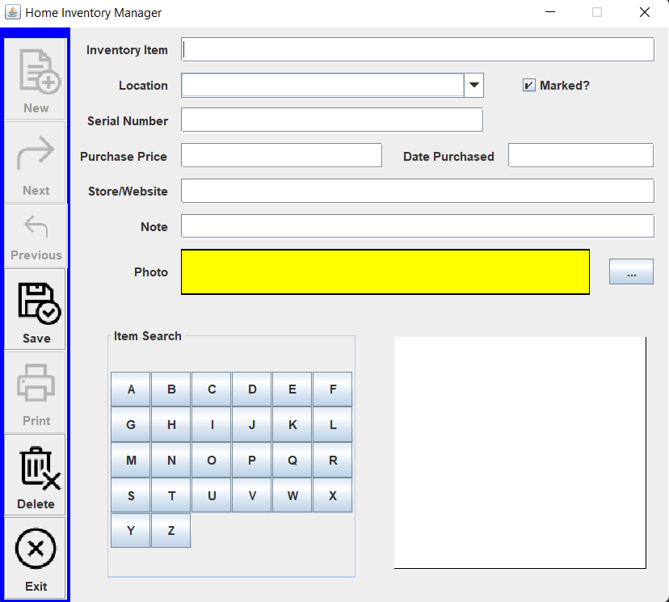
Output :
( Empty Form )

Slide 7
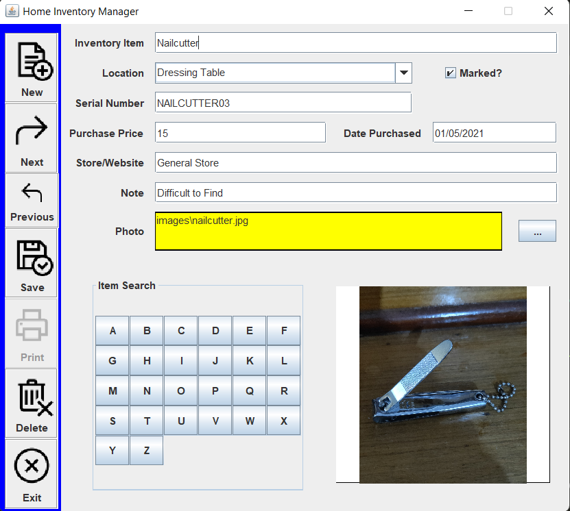
( Filled Form )

Slide 8
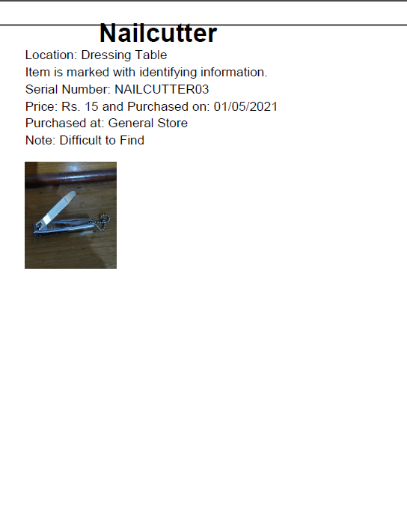
( Resultant Output )

Slide 9
Reference :
Java reference - Java Tutorial - Tutorialspoint.dev

Slide 10
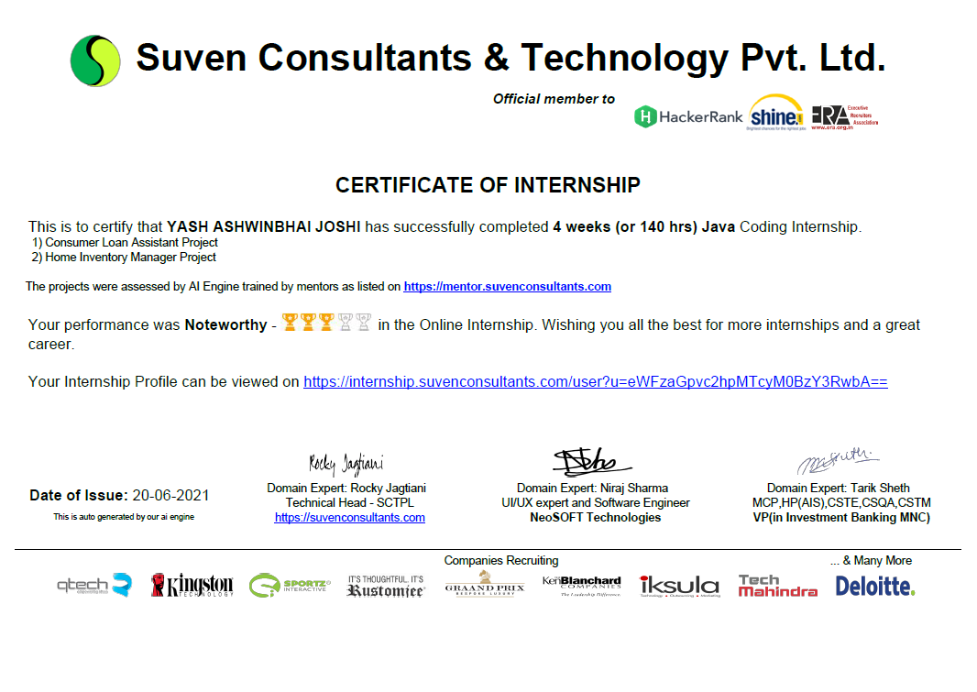
Certificate :

Slide 11
Thank You

